Slide 1

Smart To-Do List Application
Built with Python & Tkinter
Presented by: [Eshat]
Date: October 2025

Slide 2
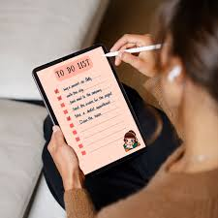
Smart To-Do List Application
Eshat Rahman [29]
Md Fazle Rabby [22]
Tasmim Rahman[04]
Tasmin Rahman [05]
Presented by: [Eshat]

Slide 3



The Problem: Why Build a To-Do List App?
Productivity Gap
Focus & Speed
Tech Stack Simplicity
Over 70% of people struggle with effective task management, leading to lost time and increased stress.
Desktop applications offer a fast, distraction-free environment ideal for quick task handling and tracking.
Python and Tkinter provide a lightweight, accessible framework for creating simple, yet robust, cross-platform GUI apps.

Slide 4




Core Features of Our To-Do Application
Piority Tagging
Add , Edit , Delete Task
Status Toggle
Save / Load task
Sort by Priority
Auto categorization

Slide 5
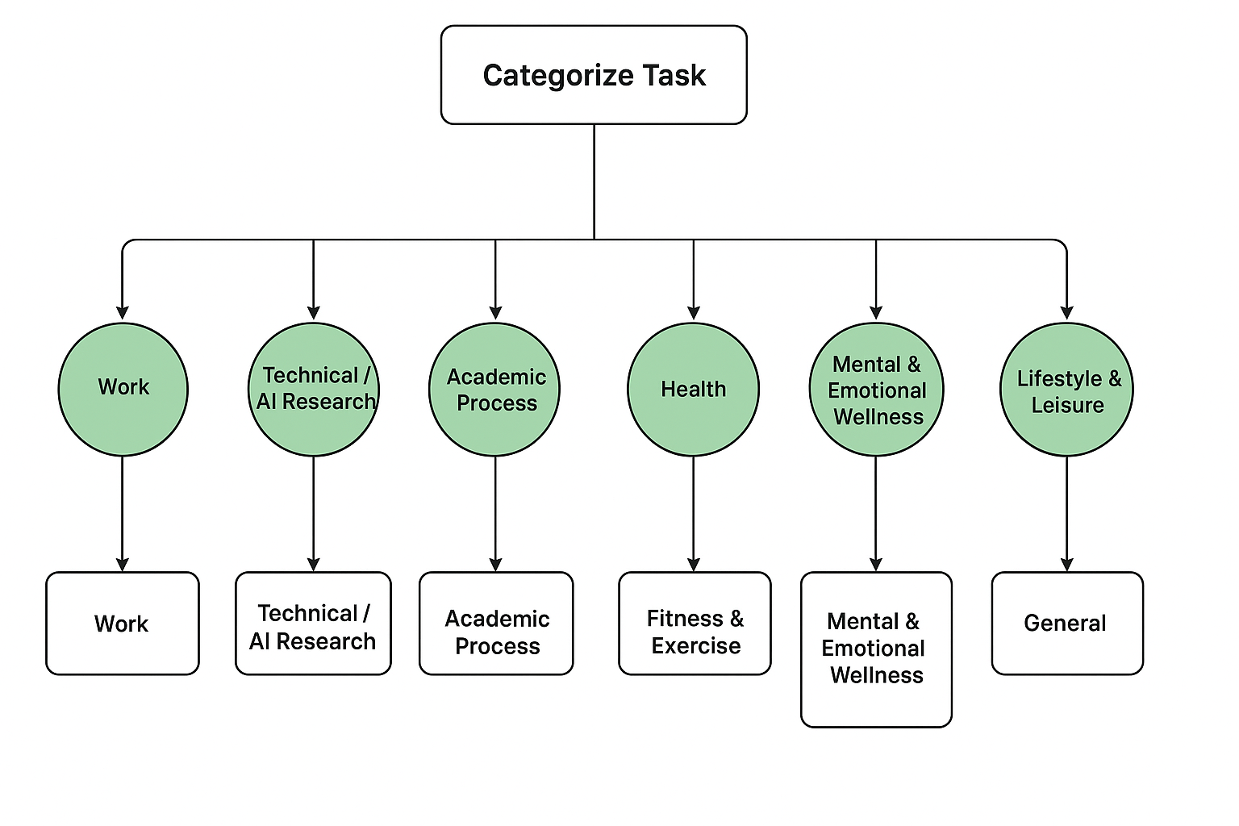

Slide 6
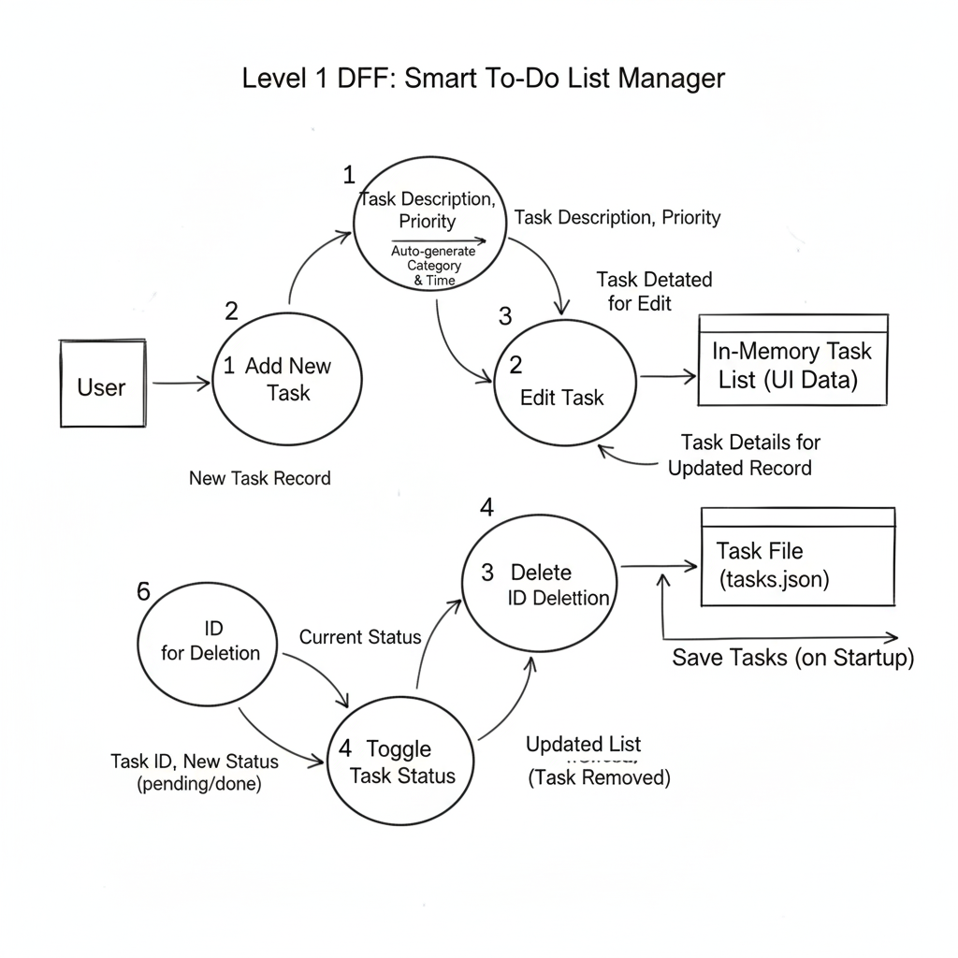

Slide 7
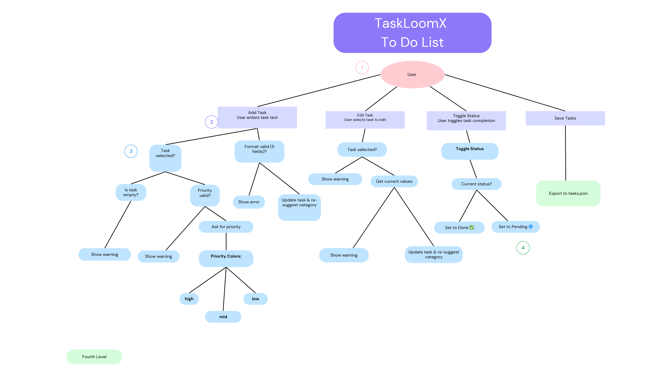

Slide 8

Structured Logic
IF user wants to add a task
THEN prompt for task name, description, due date, and category
AND save the task to the task list
IF user wants to view tasks
THEN display all tasks
OR display tasks filtered by category or due date
IF user wants to update a task
THEN prompt for task ID or name
AND allow changes to name, description, due date, or category
IF user wants to mark a task as completed
THEN update the task status to "Completed“
IF user wants to delete a task
THEN prompt for task ID or name
AND remove the task from the task list
IF user wants to categorize tasks
THEN allow selection or creation of categories
AND assign category to the task
IF user wants to prioritize tasks
THEN allow setting priority level (High, Medium, Low)
AND sort tasks by priority
IF user wants AI suggestions
THEN analyze task content and due date
AND suggest priority or category automatically

Slide 9
Condition Stub | 1 | 2 | 3 | 4 | 5 | 6
IF user wants to add a task? | Y | N | N | N | N | N
IF user wants to view tasks? | N | Y | N | N | N | N
IF user wants to update a task? | N | N | Y | N | N | N
IF user wants to mark task completed? | N | N | N | Y | N | N
IF user wants to delete a task? | N | N | N | N | Y | N
IF user wants AI suggestions? | N | N | N | N | N | Y
Action Stub | 1 | 2 | 3 | 4 | 5 | 6
Prompt for name, description, due date, category | X
Display all or filtered tasks |  | X
Prompt for task ID/name and allow editing |  |  | X
Update status to “Completed” |  |  |  | X
Remove task from list |  |  |  |  | X
Analyze task and suggest category/priority |  |  |  |  |  | X

Slide 10
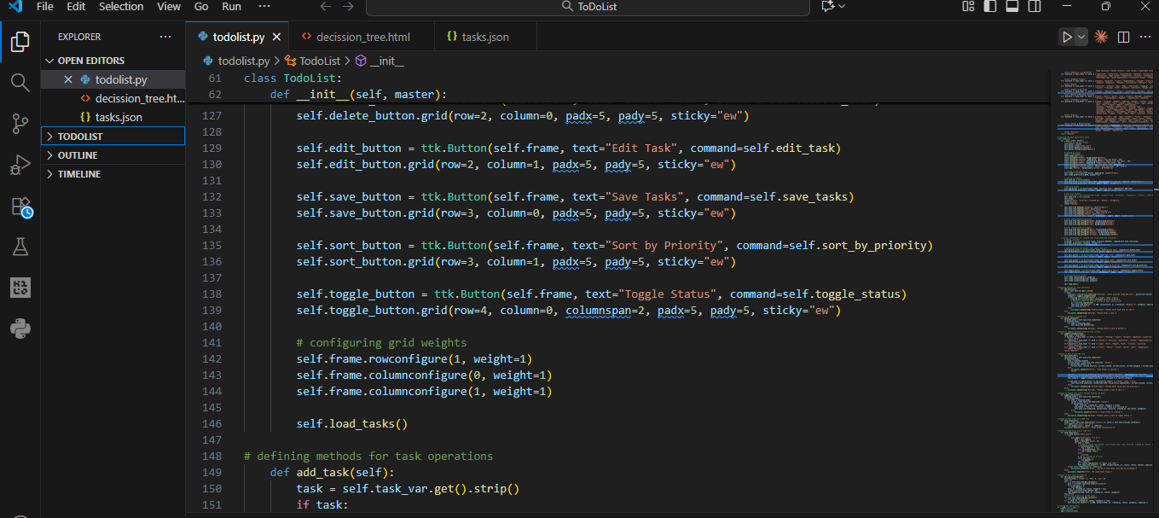
Visual Walkthrough of the Application

Slide 11
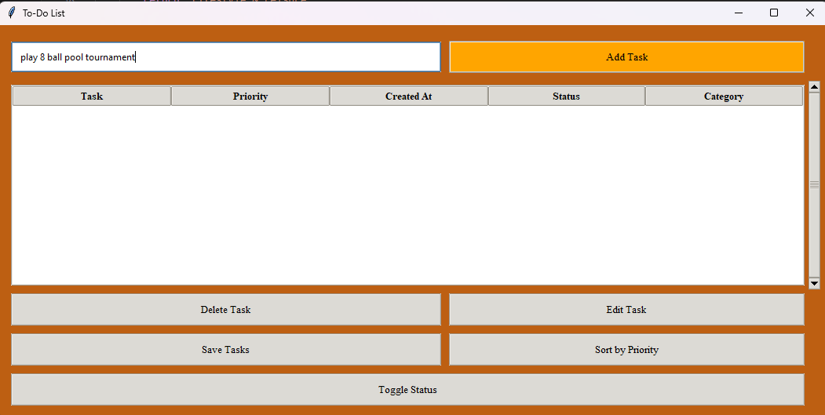
Visual Walkthrough of the Application

Slide 12
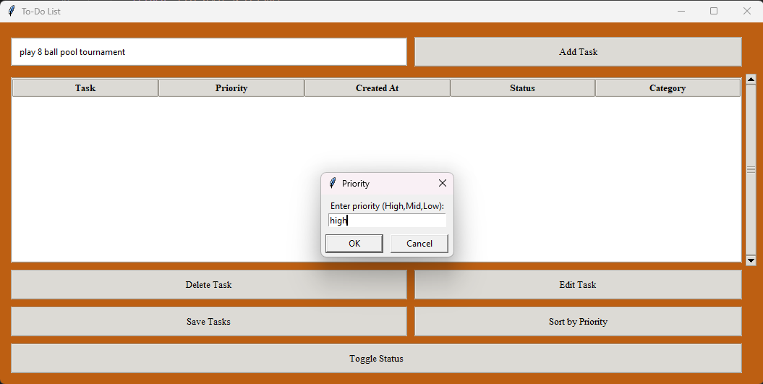
Visual Walkthrough of the Application

Slide 13
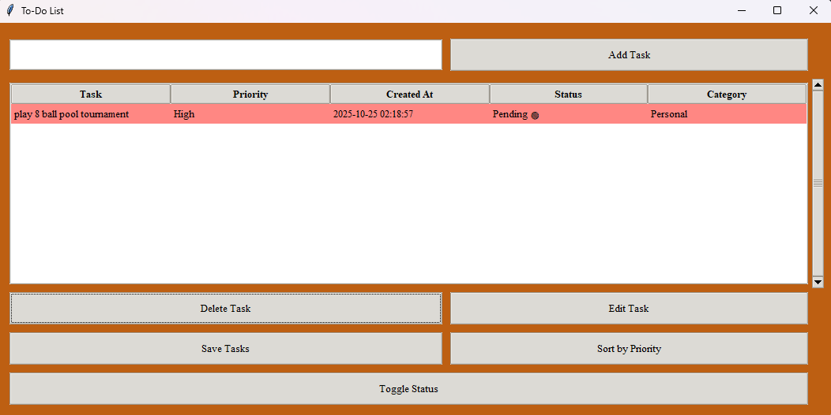
Visual Walkthrough of the Application

Slide 14
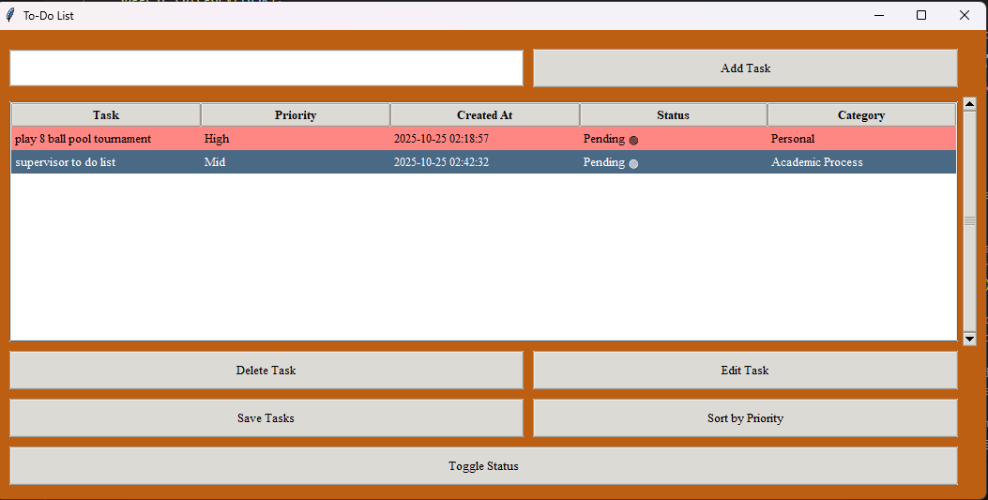
Visual Walkthrough of the Application

Slide 15
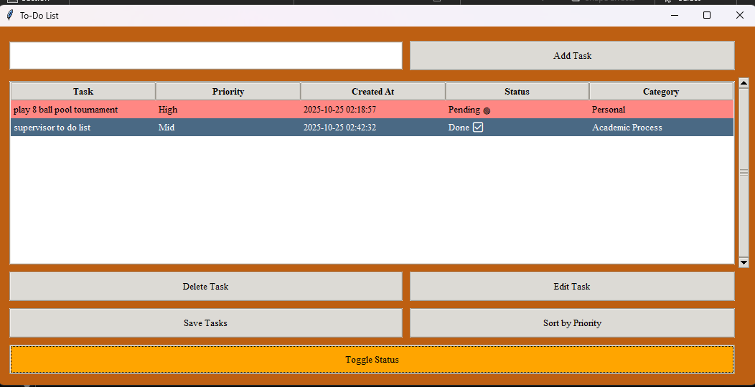
Visual Walkthrough of the Application

Slide 16
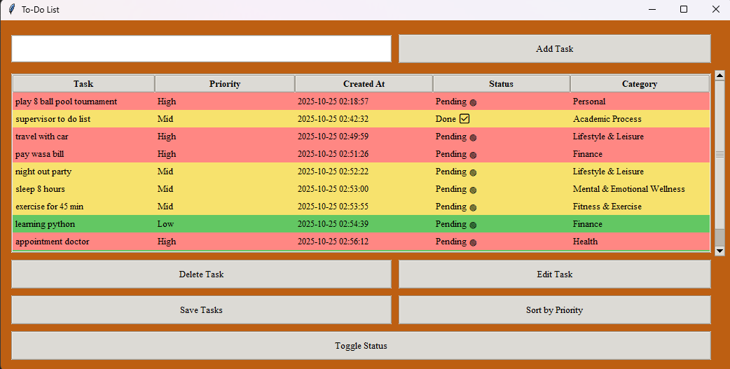
Visual Walkthrough of the Application

Slide 17
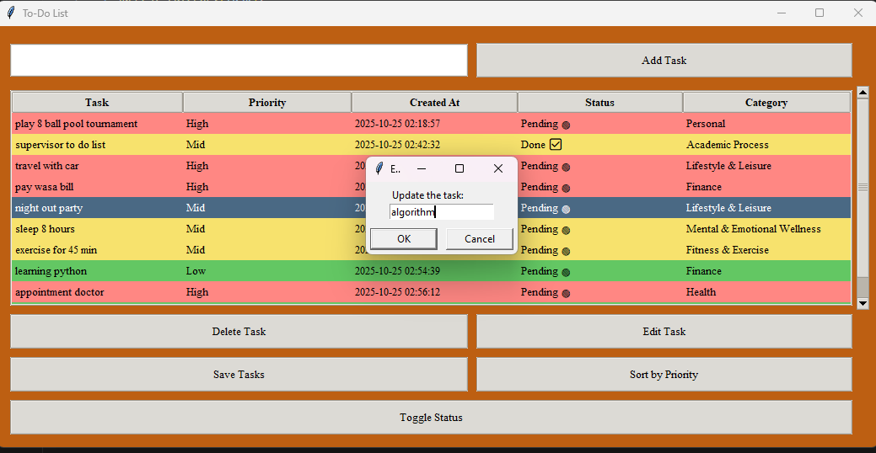
Visual Walkthrough of the Application

Slide 18
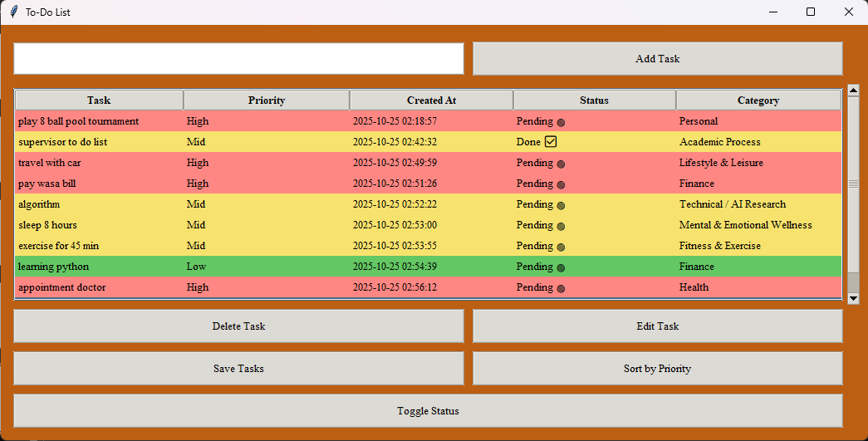
Visual Walkthrough of the Application

Slide 19
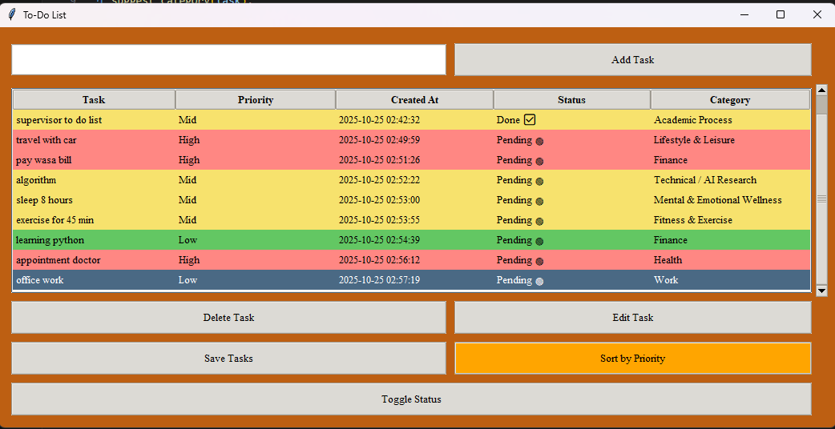
Visual Walkthrough of the Application

Slide 20
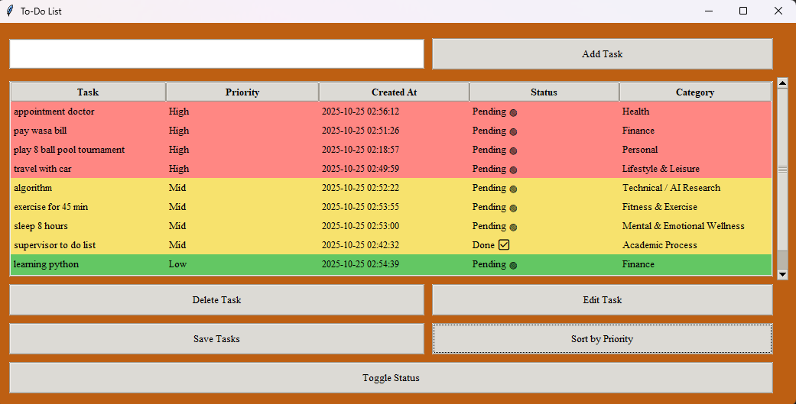
Visual Walkthrough of the Application

Slide 21
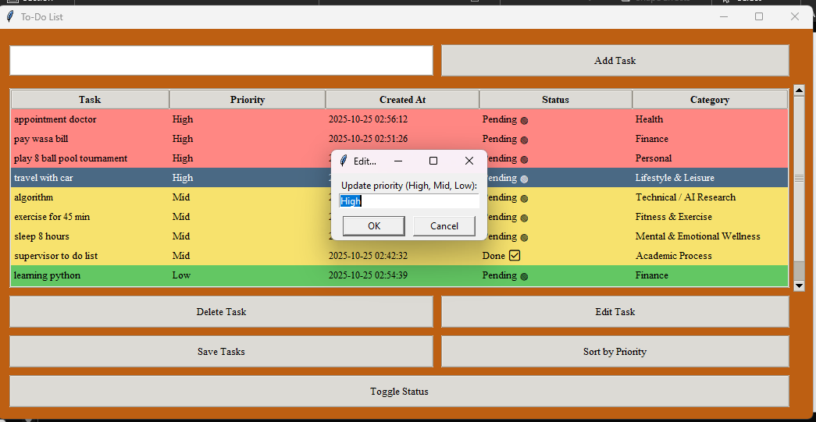
Visual Walkthrough of the Application

Slide 22
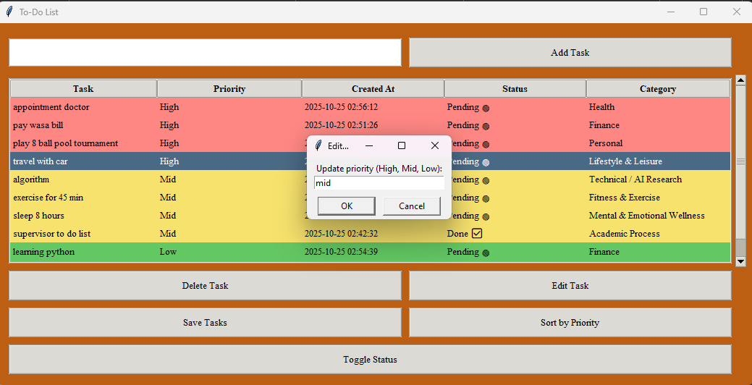
Visual Walkthrough of the Application

Slide 23
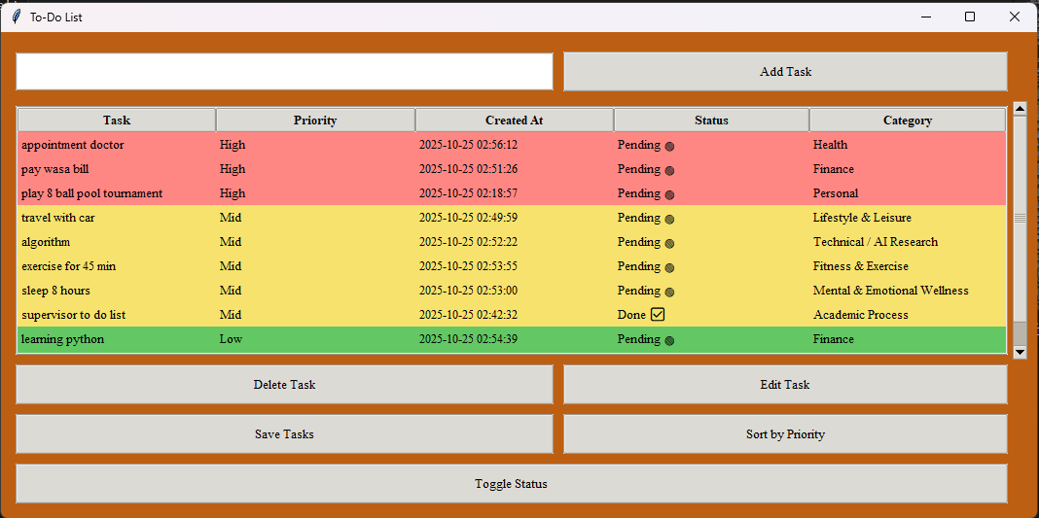
Visual Walkthrough of the Application

Slide 24
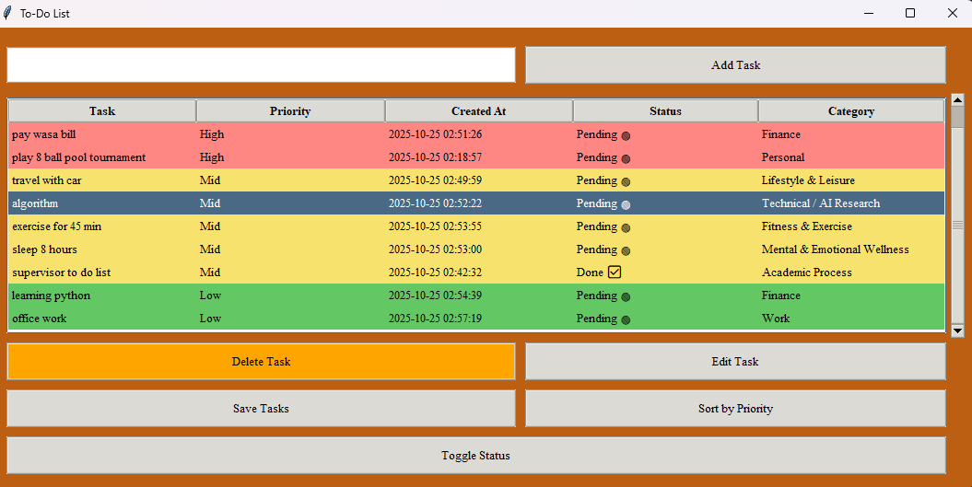
Visual Walkthrough of the Application

Slide 25
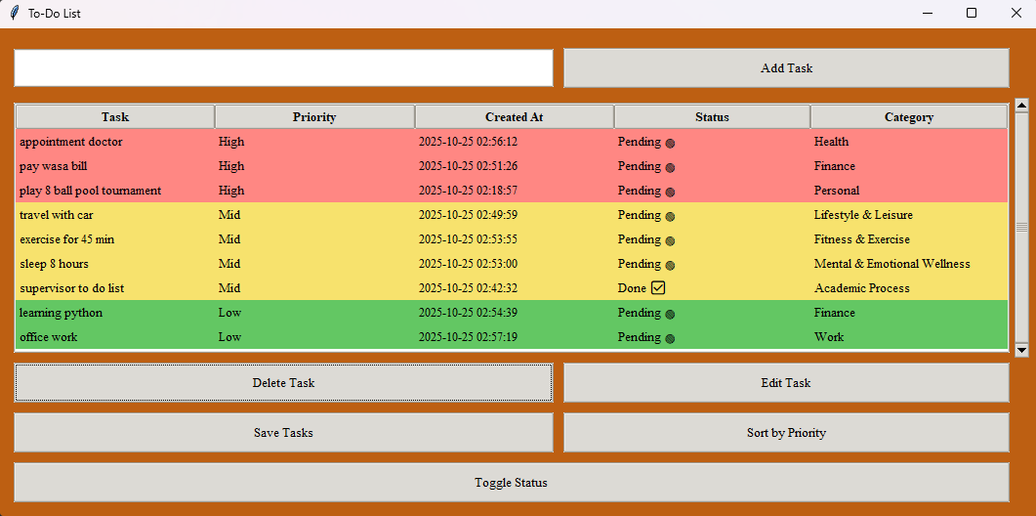
Visual Walkthrough of the Application

Slide 26
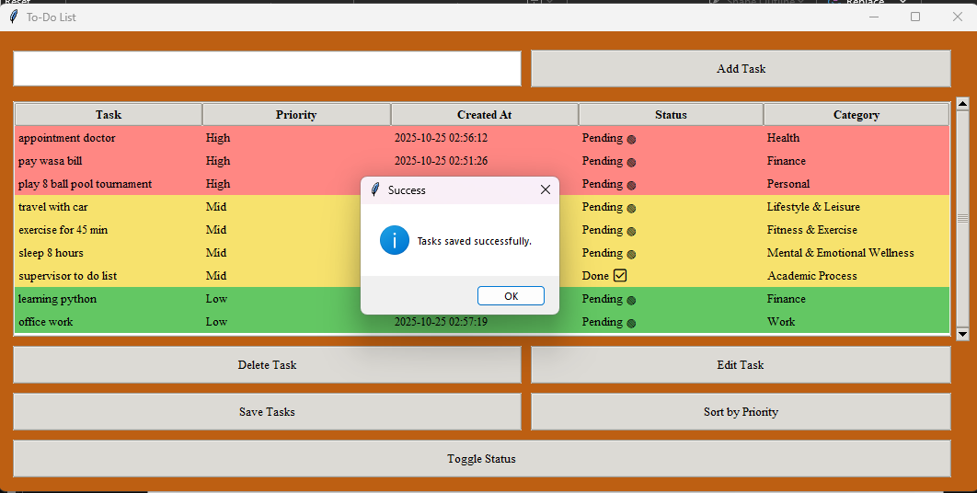
Visual Walkthrough of the Application

Slide 27

Resources & Learning Links
Source Code & Tutorial
Access the full project source code and a detailed tutorial on our GitHub Repository.
Video Walkthrough
Watch the "Python tkinter Tutorial: Simple To Do List App" on YouTube for a step-by-step visual guide to building the app.
Official Documentation
For deeper learning on Tkinter, consult the official Python 3 documentation.

Slide 28


Slide 29
